Slide 1
Is pizza a soup or a salad?

Slide 2
Communicating Research with Effective Data Visualization
AFS2024 Workshop - Day 1
Megumi Oshima & Pavel Dimens

Slide 3

Plotz

Slide 4
Being Practical
Is the plot conveying the information I want it to convey?
Does anyone-who-isn’t-me understand this?
Is there too little information? Too much?

Slide 5
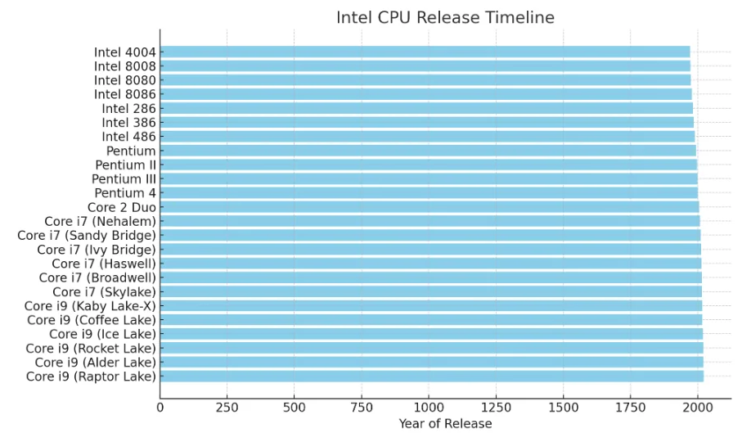
Being Practical
Is the plot conveying the information I want it to convey?
Does anyone-who-isn’t-me understand this?
Is there too little information? Too much?

Slide 6
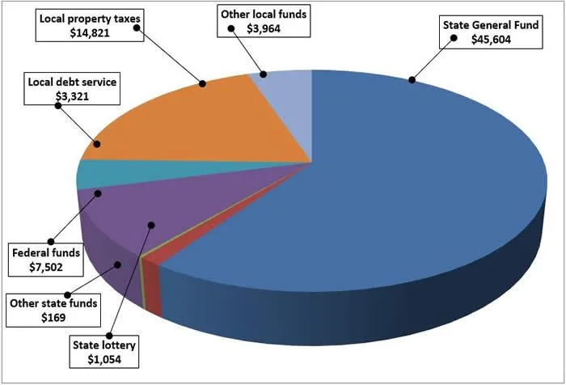
Being Practical
Is the plot conveying the information I want it to convey?
Does anyone-who-isn’t-me understand this?
Is there too little information? Too much?
Notes:
Where California gets education money

Slide 7
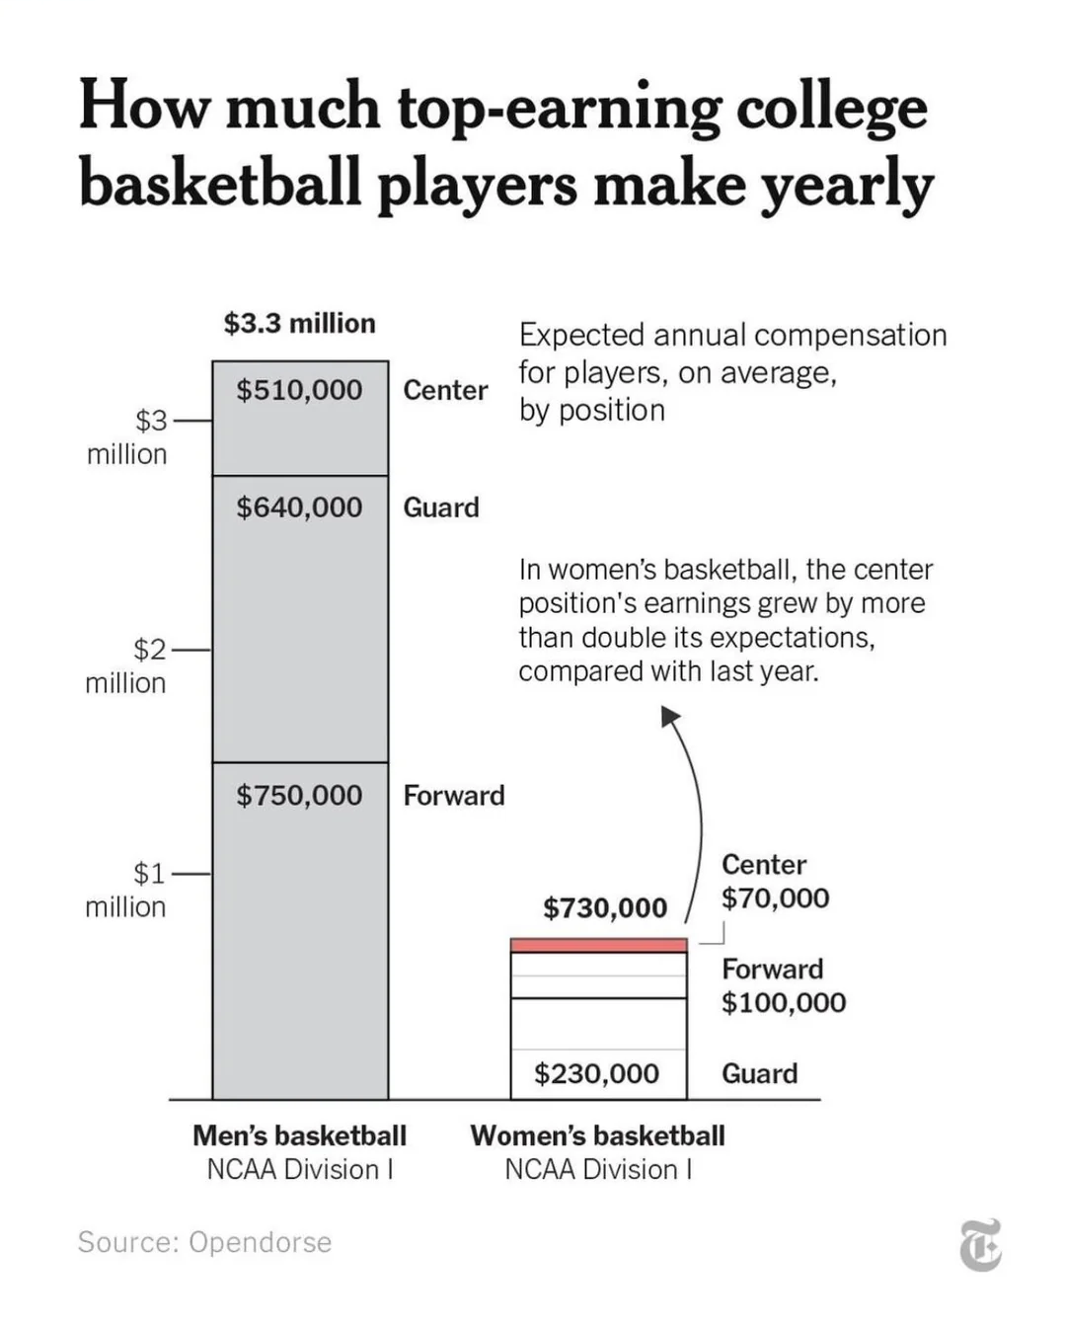
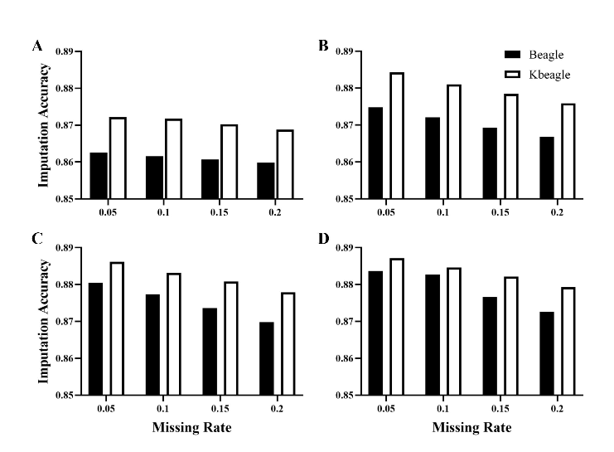
Being Practical
Is the plot conveying the information I want it to convey?
Does anyone-who-isn’t-me understand this?
Is there too little information? Too much?
Notes:
The scale is wrong

Slide 8
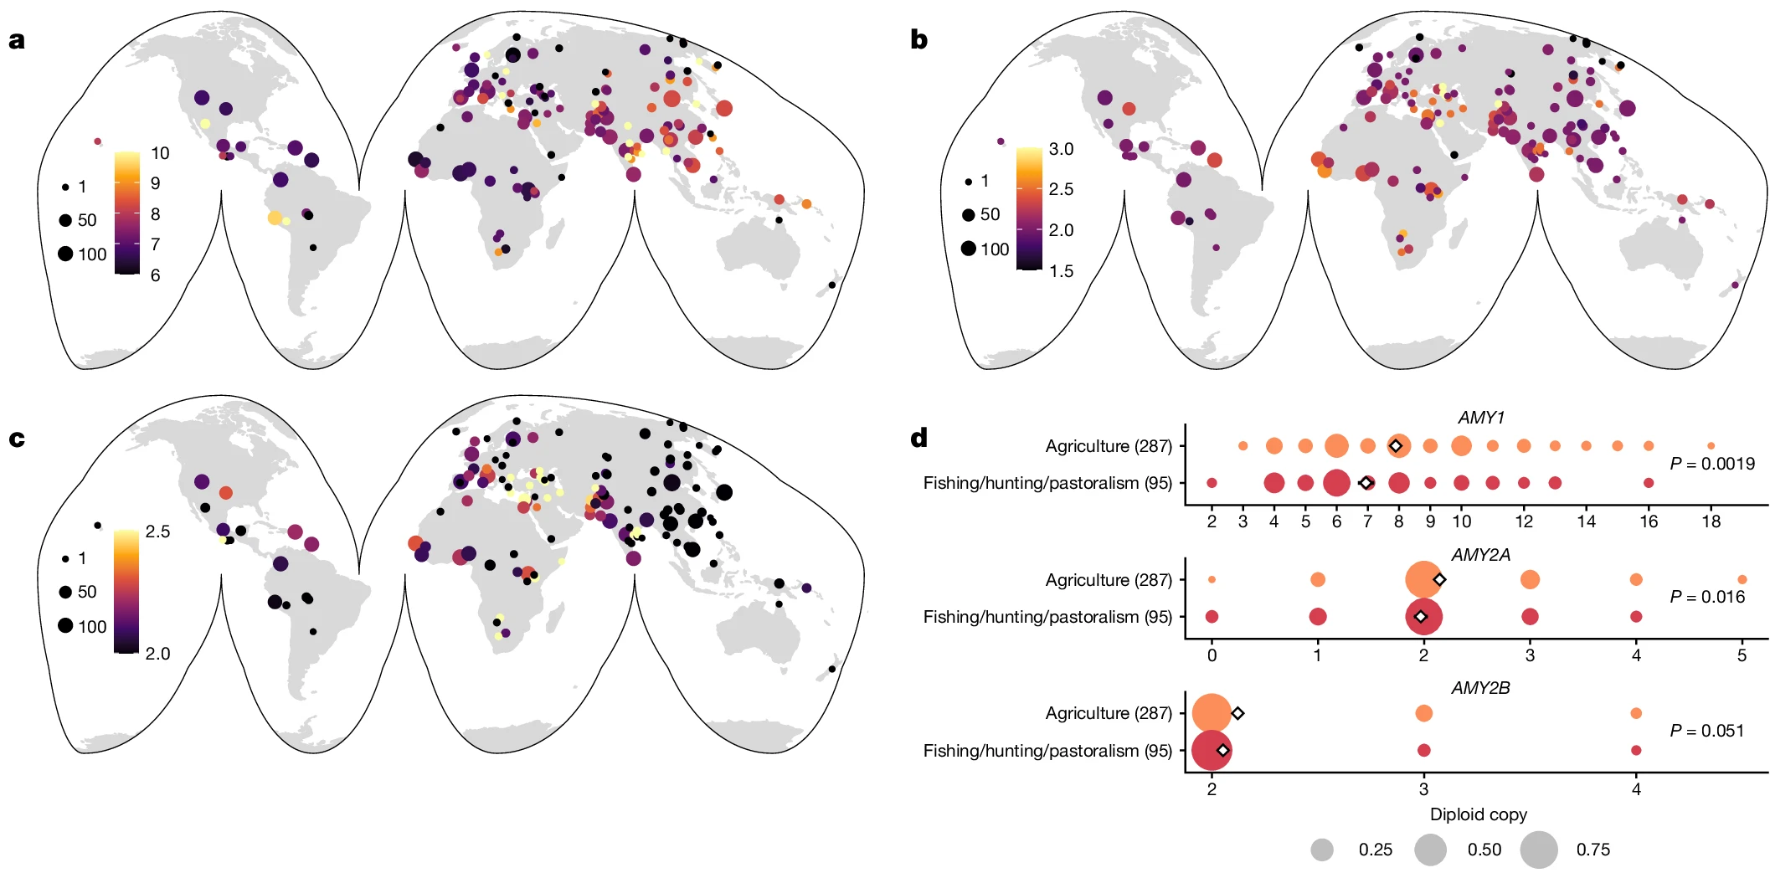
Being Practical
Is the plot conveying the information I want it to convey?
Does anyone-who-isn’t-me understand this?
Is there too little information? Too much?

Slide 9
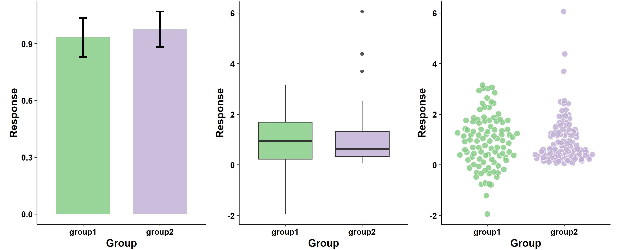
Being Practical
Is the plot conveying the information I want it to convey?
Does anyone-who-isn’t-me understand this?
Is there too little information? Too much?
👌
👍
🙌

Slide 10
5 Minute Break

Slide 11

ggplot2::ggplot()
Plotting the “grammar of graphics” way

Slide 12
Tidy data
Month | FishID_001 | FishID_002 | FishID_003 | FishID_004
4 | 3 | 7.5 | 3.2 | 10
5 | 3.6 | 8 | 4 | 10.5
6 | 4.2 | 8.4 | 4.3 | 11
7 | 4.7 | 9.5 | 5.1 | 12
Month | FishID | TL
4 | 001 | 3
4 | 002 | 7.5
4 | 003 | 3.2
4 | 004 | 10
5 | 001 | 3.6
5 | 002 | 8
5 | 003 | 4
5 | 004 | 10.5
Long
Wide
Notes:
The first step of creating a plot with ggplot is to tidy data into the correct format. “Long” vs “wide”
Long data frames have one row for every observation and a column for each variable
This example I have each fish as a separate column and the month that the length observation was taken as the rows
This makes it easier to aggregate and separate your data to make different kinds of plots without having to change the input style

Slide 13
Data properties → Visual properties
FishID | TL | Age
001 | 3 | 5
002 | 3.2 | 7.5
003 | 8.9 | 10
004 | 9.5 | 12
005 | 6 | 8
Notes:
Once you have your data table in the long form, you want to represent the numbers or categories or text in it, in a visual way. This concept is referred to as mapping. Mapping is just corresponding the properties of the data to visual properties in a graphic. For example, we have total length and age, that we are going to map to y and x positions, and then we will map those into points at those positions.

Slide 14
Data properties → Visual properties
FishID | y | x
001 | 3 | 5
002 | 3.2 | 7.5
003 | 8.9 | 10
004 | 9.5 | 12
005 | 6 | 8
Notes:
Once you have your data table in the long form, you want to represent the numbers or categories or text in it, in a visual way. This concept is referred to as mapping. Mapping is just corresponding the properties of the data to visual properties in a graphic. For example, we have total length and age, that we are going to map to y and x positions, and then we will map those into points at those positions.

Slide 15
Data properties → Visual properties
FishID | y | x
001 | 3 | 5
002 | 3.2 | 7.5
003 | 8.9 | 10
004 | 9.5 | 12
005 | 6 | 8
Notes:
Once you have your data table in the long form, you want to represent the numbers or categories or text in it, in a visual way. This concept is referred to as mapping. Mapping is just corresponding the properties of the data to visual properties in a graphic. For example, we have total length and age, that we are going to map to y and x positions, and then we will map those into points at those positions.

Slide 16
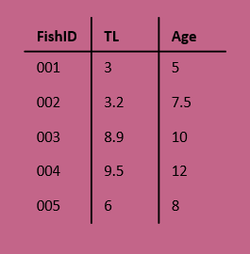
Components of a ggplot
Coordinates
(x, y)
Mapping
Data
Facets
Layers
Theme
Scales

Slide 17
Components of a ggplot
Data
Mapping
Layers
Scales
(x, y)
Facets
Coordinates
Theme
Notes:
Scale controls the mapping of values in the data space to values in the aesthetic space – taking a categorical variable like sex, and turning those into categories 1,2,3,4 and then using those to index what color to use from a vector of colors
Another example: continuous y scale maps larger numbers to vertically higher positions in space

Slide 18
Building a ggplot
Data
Mapping
Layers
(x, y)
Notes:
Data – consists of varaibles
Mapping – corresponding data properties to visual properties
Aesthetics – visual properties of geoms (line color, point shape, positions, etc)
Geoms – geometric objects that represent the data (lines, points, bars, etc)

Slide 19
Building a ggplot
Data
Mapping
Layers
ggplot(
data = blackdrum
)
(x, y)

Slide 20
Building a ggplot
Data
Mapping
Layers
ggplot(
data = blackdrum
)
ggplot(
data = blackdrum,
mapping = aes(
x = tl,
y = otoage
)
)
(x, y)
Notes:
Mapping is the set of instructions on how to make pairs of graphical attributes and parts of the data

Slide 21
Building a ggplot
Data
Mapping
Layers
ggplot(
data = blackdrum
)
ggplot(
data = blackdrum,
mapping = aes(
x = tl,
y = otoage
)
)
geom_line() +
geom_point()
+
(x, y)
Notes:
Layers are what take the mapped data and display it into a graph. Layers have 3 parts, geometry (aka how the data is displayed-line, points, bars, etc), statistical transformations (e.g. adding a trendline), position adjustments (where the data is being shown on the graph)

Slide 22
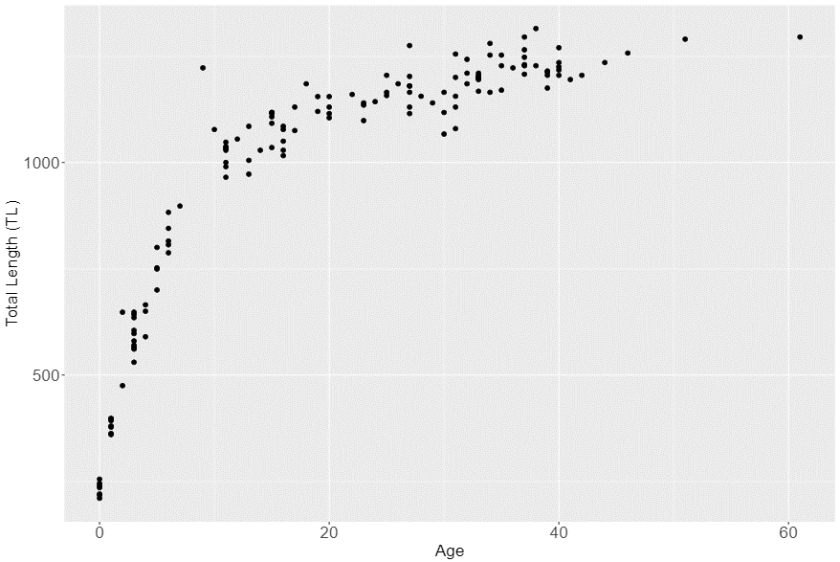
Syntax of a ggplot
ggplot(
data = blackdrum,
mapping = aes(
x = otoage,
y = tl
)
) +
geom_point() +
labs(
x = “Total Length (TL)”,
y = “Age”
) +
theme_bw()
(x, y)
Notes:
Layers are what take the mapped data and display it into a graph. Layers have 3 parts, geometry (aka how the data is displayed-line, points, bars, etc), statistical transformations (e.g. adding a trendline), position adjustments (where the data is being shown on the graph)

Slide 23
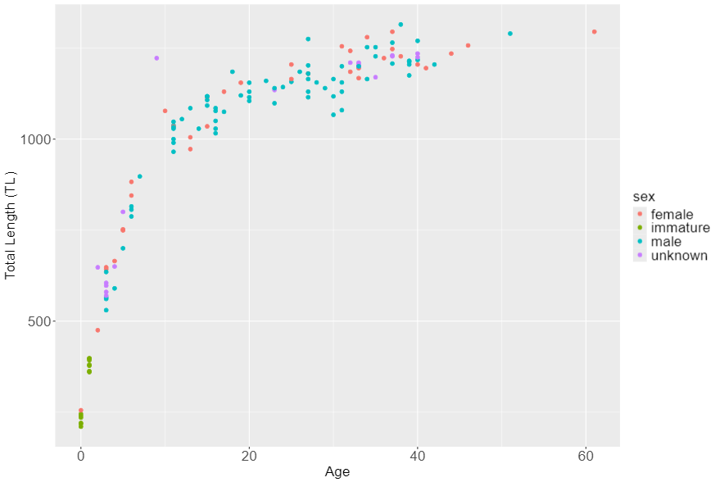
Syntax of a ggplot
ggplot(
data = blackdrum,
mapping = aes(
x = otoage,
y = tl
)
) +
geom_point(
mapping = aes(
color = sex
)
) +
labs(
x = “Total Length (TL)”,
y = “Age”
) +
theme_bw()
(x, y)
Notes:
Layers are what take the mapped data and display it into a graph. Layers have 3 parts, geometry (aka how the data is displayed-line, points, bars, etc), statistical transformations (e.g. adding a trendline), position adjustments (where the data is being shown on the graph)

Slide 24
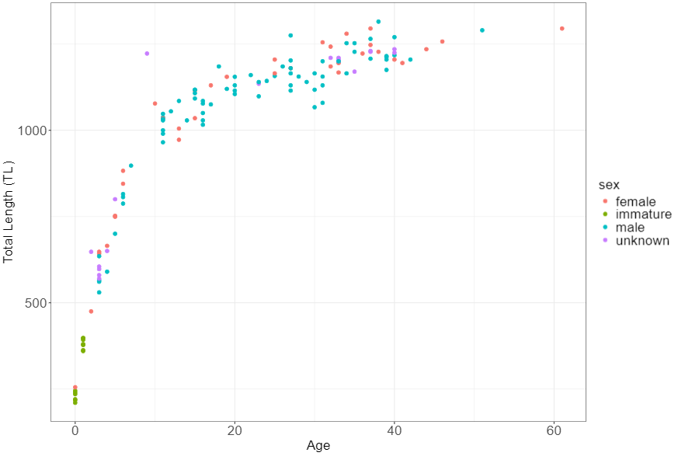
Syntax of a ggplot
ggplot(
data = blackdrum,
mapping = aes(
x = otoage,
y = tl
)
) +
geom_point(
mapping = aes(
color = sex
)
) +
labs(
x = “Total Length (TL)”,
y = “Age”
) +
theme_bw()
(x, y)
Notes:
Layers are what take the mapped data and display it into a graph. Layers have 3 parts, geometry (aka how the data is displayed-line, points, bars, etc), statistical transformations (e.g. adding a trendline), position adjustments (where the data is being shown on the graph)

Slide 25
Hands on activity
Create a ggplot to show the spread of Black Drum lengths by month
Notes:
Geom_histogram
Geom_boxplot
Geom_violin

Slide 26
5 Minute Break

Slide 27
Using aesthetics to convey your message
(x, y)

Slide 28
Scales
Turn your data into something you can see
Color
Size
.
Position
Shape
(x, y)

Slide 29
Scales
Turn your data into something you can see
Color
Size
.
Position
Shape
(x, y)

Slide 30


Color – convey meaning
Not ideal
Better
(x, y)
Notes:
Color is a great way to quickly convey a message with your visualization.

Slide 31
Color - continuity
A
A
B
B
C
C
A
B
C
A
B
C
Not ideal
Better
(x, y)

Slide 32
Color - contrast
Not ideal
Better
(x, y)

Slide 33
Color – (de)emphasize
Not ideal
Better
(x, y)
Notes:
Enough contrast between colors
Lightness
Hue
Saturation
Can add a thin outline between adjacent colors
Many visualizations benefit from emphasizing only a few categories and de-emphasizing the rest.

Slide 34
Size –relativity
1
2
3
4
1
2
3
4
Not ideal
Better
(x, y)

Slide 35
Shape – give visual clues
Mako
4
Mako
Blue
2
Blue
Spiny Dogfish
3
Spiny Dogfish
Not ideal
Better
(x, y)

Slide 36
Shape – mix ‘n match
Not ideal
Better
(x, y)

Slide 37
Hands on activity
Find a color palette you like and share with your neighbor
Notes:
What do you like about the color palette? What kind of data would it work for? Continuous, sequential, diverging, discrete? Are there any issues with it?

Slide 38
5 Minute Break

Slide 39
Let’s do better, together
Goals
Less intense
↓ stuff
More color
Emphasize DIFFERENCES

Slide 40
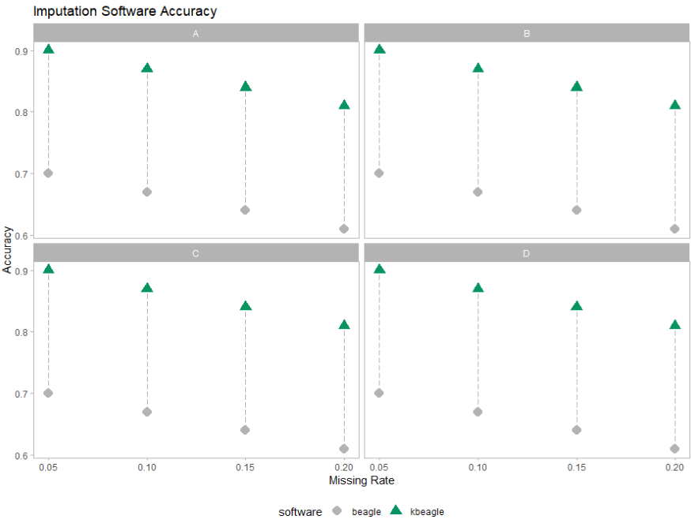
Goals
Less intense
↓ stuff
More color
Emphasize DIFFERENCES

Slide 41
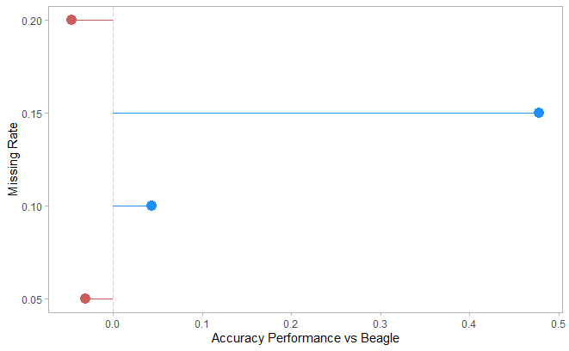
Goals
Less intense
↓ stuff
More color
Emphasize DIFFERENCES

Slide 42
5 Minute Break

Slide 43
Advanced plotting
(x, y)

Slide 44
Facets
Coordinates
Theme
(x, y)
+ facet_wrap()
+ facet_grid()

Slide 45
Facets
Coordinates
Theme
(x, y)
+ facet_wrap()
+ facet_grid()
+ coord_flip()
+ coord_cartesian()
+ coord_polar()
+ theme_bw()
+ theme_classic()
+ theme()

Slide 46
Facets
Coordinates
Theme
(x, y)
+ facet_wrap()
+ facet_grid()
+ coord_flip()
+ coord_cartesian()
+ coord_polar()
+ theme_bw()
+ theme_classic()
+ theme()

Slide 47
Facets
Coordinates
Theme
(x, y)
+ facet_wrap()
+ facet_grid()
+ coord_flip()
+ coord_cartesian()
+ coord_polar()
+ theme_bw()
+ theme_classic()
+ theme()

Slide 48
Facets
1
2
3
A
A1
A2
A3
1
2
3
B
B1
B2
B3
4
5
6
facet_grid()
facet_wrap()
(x, y)
Notes:
2d vs 1d, a good way to show groups instead of using another aesthetic

Slide 49
Coordinates - flip
N
Group
Group
N
+ coord_flip()
(x, y)

Slide 50
Coordinates - zoom
35
30
25
20
15
10
5
1
2
3
4
5
6
7
+ coord_cartesian(xlim = c(2, 3))
(x, y)

Slide 51
Coordinates - zoom
35
35
30
30
25
25
20
20
15
15
10
10
5
5
1
2
3
4
5
6
7
2.0
2.2
2.4
2.6
2.8
3.0
3.2
+ coord_cartesian(xlim = c(2, 3))
(x, y)

Slide 52
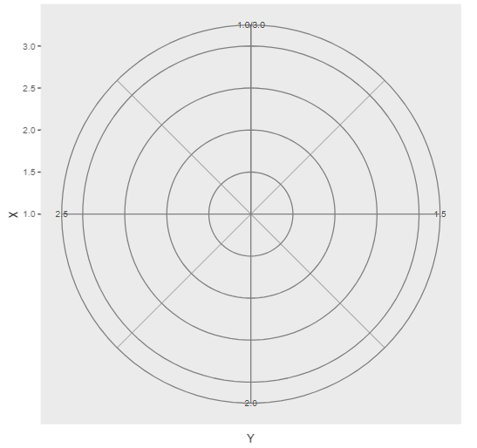
Coordinates - polar
+ coord_polar(“y”)
(x, y)
Notes:
Apply transformations to the x and y positions AFTER the data has been processed by the stat

Slide 53
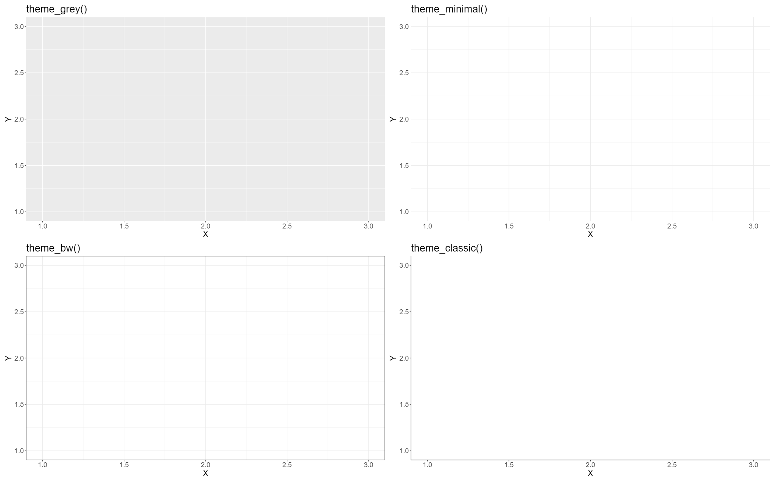
Themes – ggplot built-in
(x, y)

Slide 54
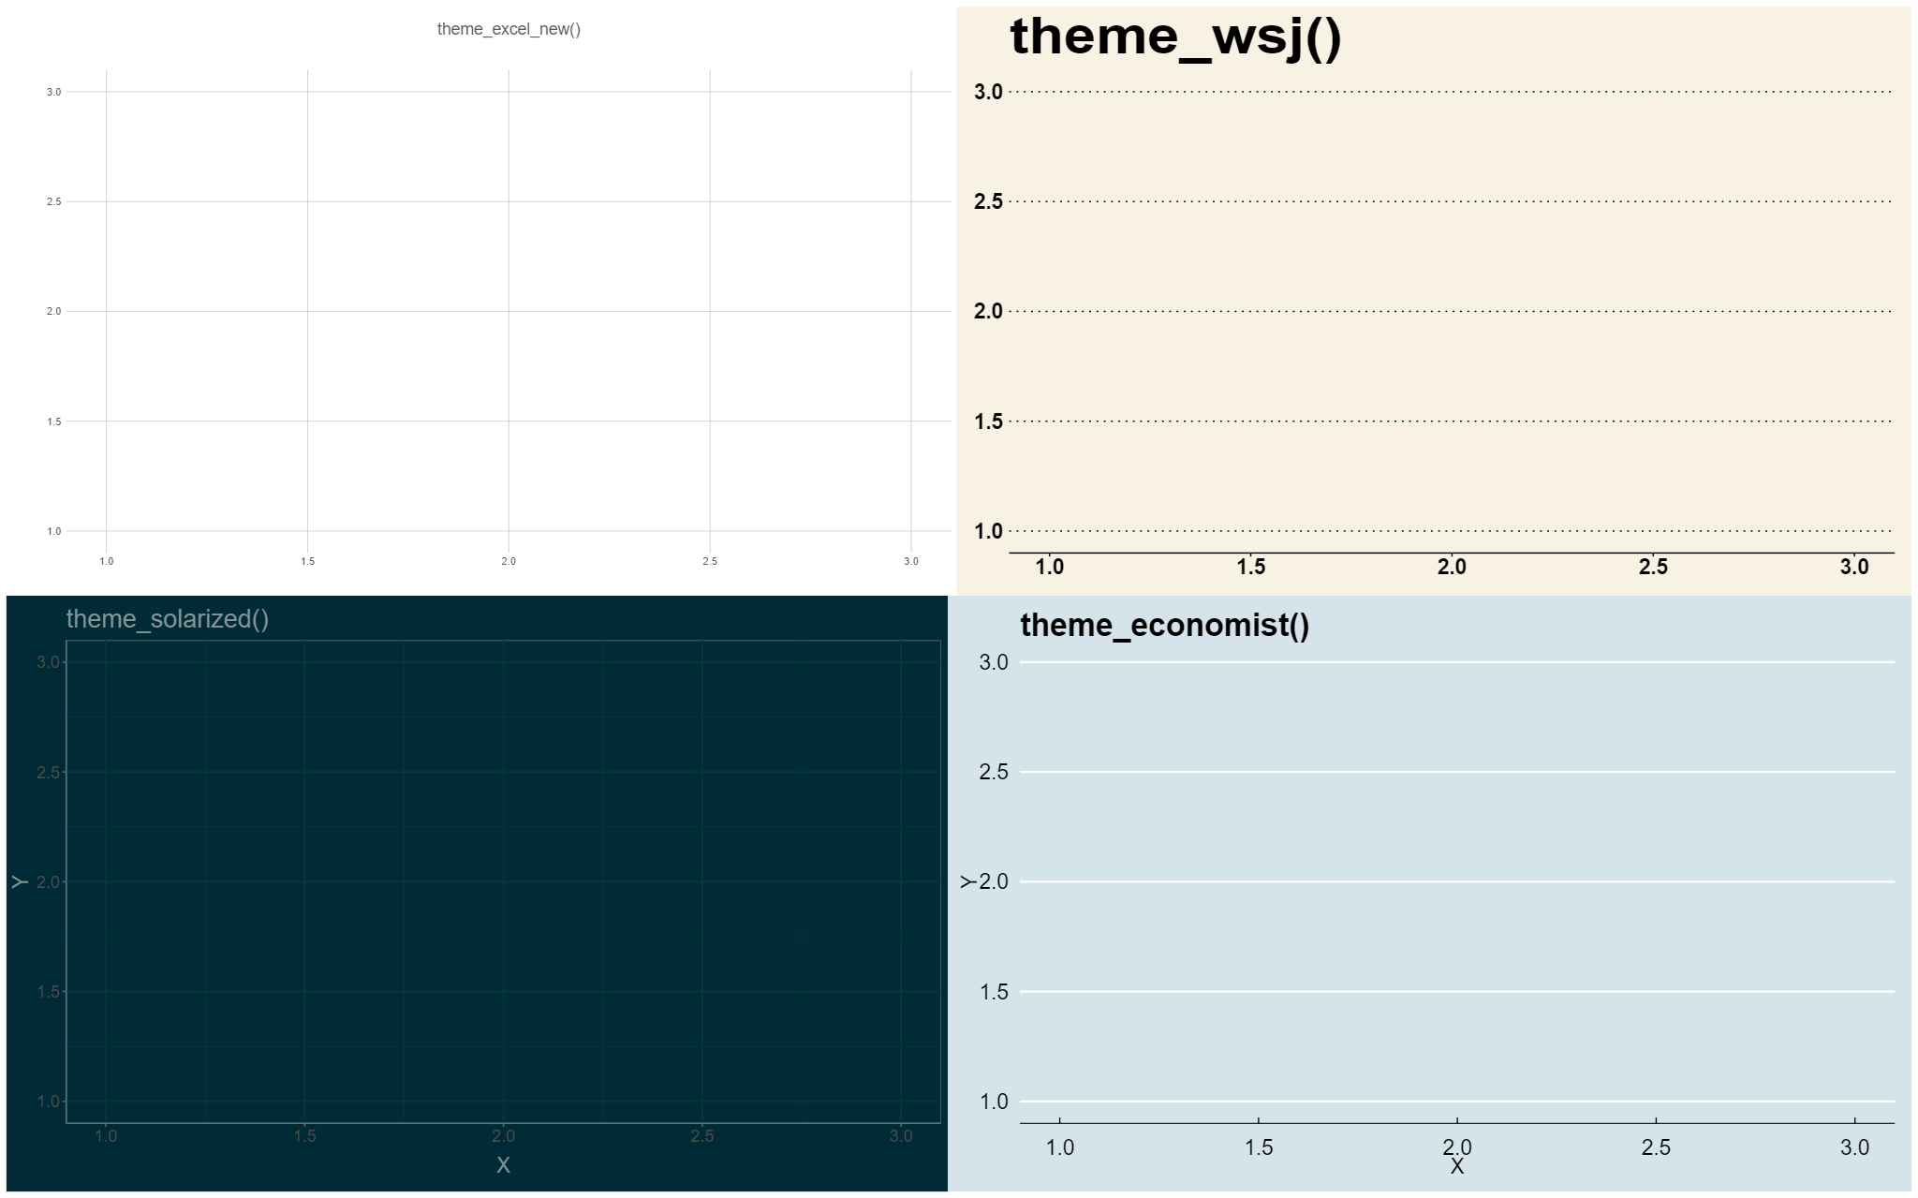
Themes -bespoke
(x, y)

Slide 55
Themes – customize elements
+ theme(
plot,
text,
panel,
axis,
legend,
gridlines
)

Slide 56
Hands on activity
Modify the `theme_AFS()` code to create a custom ggplot theme and apply to the black drum lengths by months plot

Slide 57
5 Minute Break

Slide 58
Group Project
Choose a dataset and create the plots as instructed, then improve them based on what you learned today

Slide 59

Taylor Swift Eras Tour Setlist Dataset
Goal: Create one or more plots to communicate what contributes to the popularity of songs within the setlist.
Data collected from Spotify’s Eras Tour Setlist Playlist
“./Day1/Project/TS_Eras_Exploration.csv”

Slide 60
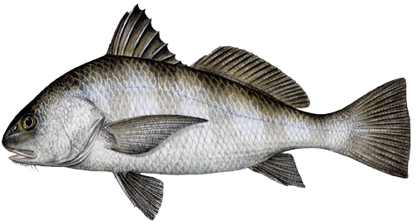
Black Drum Age and Lengths Dataset
Goal: Describe the demographics of the sampled Black Drum from Virginia in 2001
Biological data for Black Drum from Virginia waters of the Atlantic Ocean in 2001
“./Day1/Project/ BlackDrum2001_Exploration.qmd”

